Slide 1


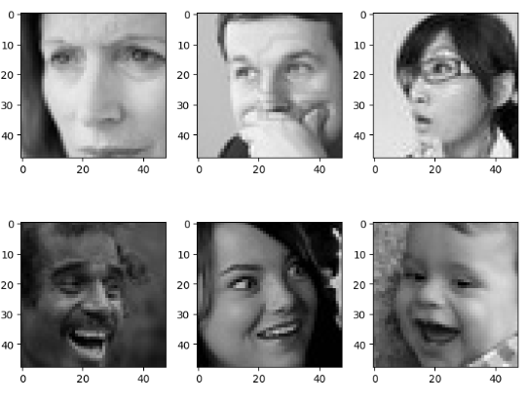
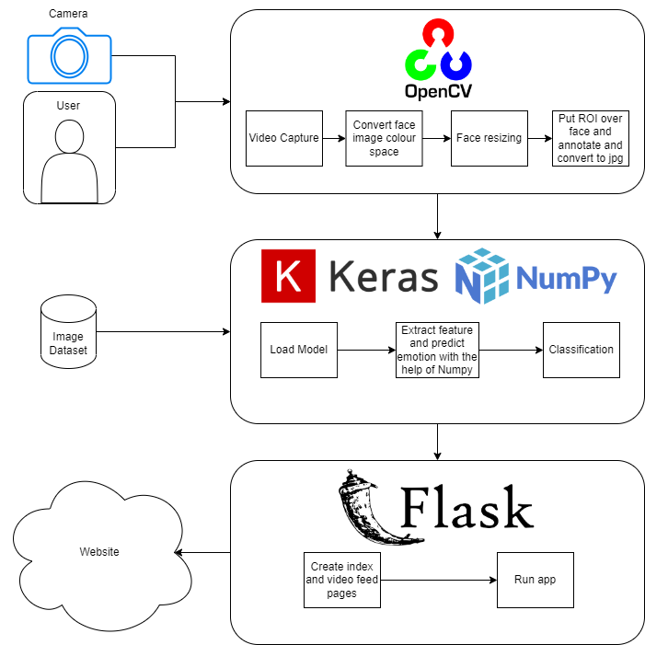
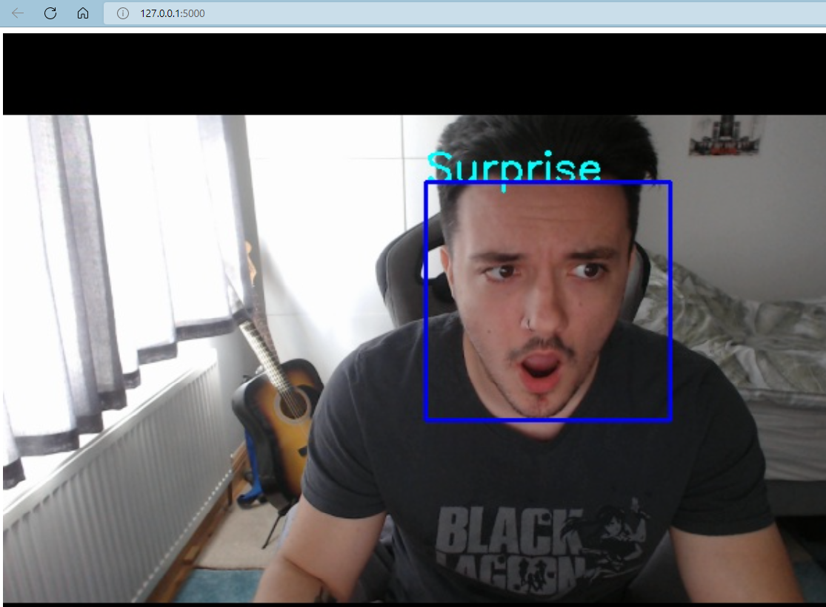
Aleksander Kosiak
Results
The result of this app, creates a localhost website, that uses a feed from the camera. It detects the face and extracts the emotion, classifying it to the correct reaction. All of this is processed in the backend code when the Flask app is called and run in the main file. The main file calls a function from another file that detects the face, which then in turn invokes a Keras focused file that handles the emotion detection using models.
Introduction
Emotion detection in the tech industry is not utilized to its full potential yet, so I have decided to create an accurate app that lets the user have their emotion detected online for any future application that it may bring.
Background
From working in a tech company as a software engineer, I have discovered the potential of object and face detection and wanted to dive further into human interaction with software. This is where I became interested seeing how far emotion detection can push this industry.
Research
For this to work I needed to use a camera, which was my Logitech webcam. From my research I found that Flask would work best with a web application displaying video. Its compatible with the OpenCV library which fits my standards. I also used Keras to prepare the model and predict the emotion which was used in combination with Numpy to grab the maximum value indice of the emotion.

